Slide 1
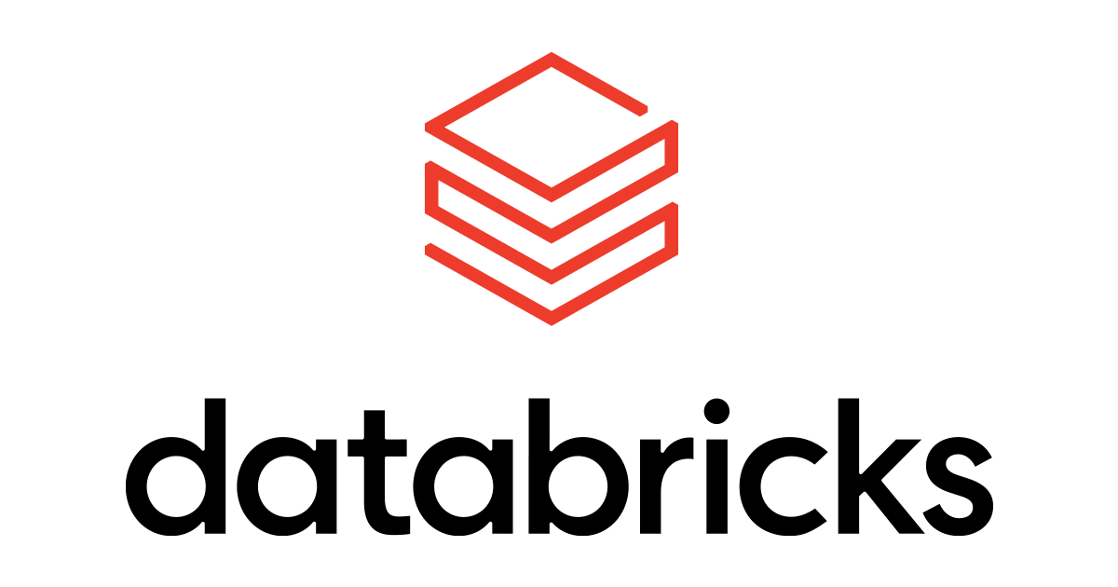
Agents with
Azure Databricks

Slide 2
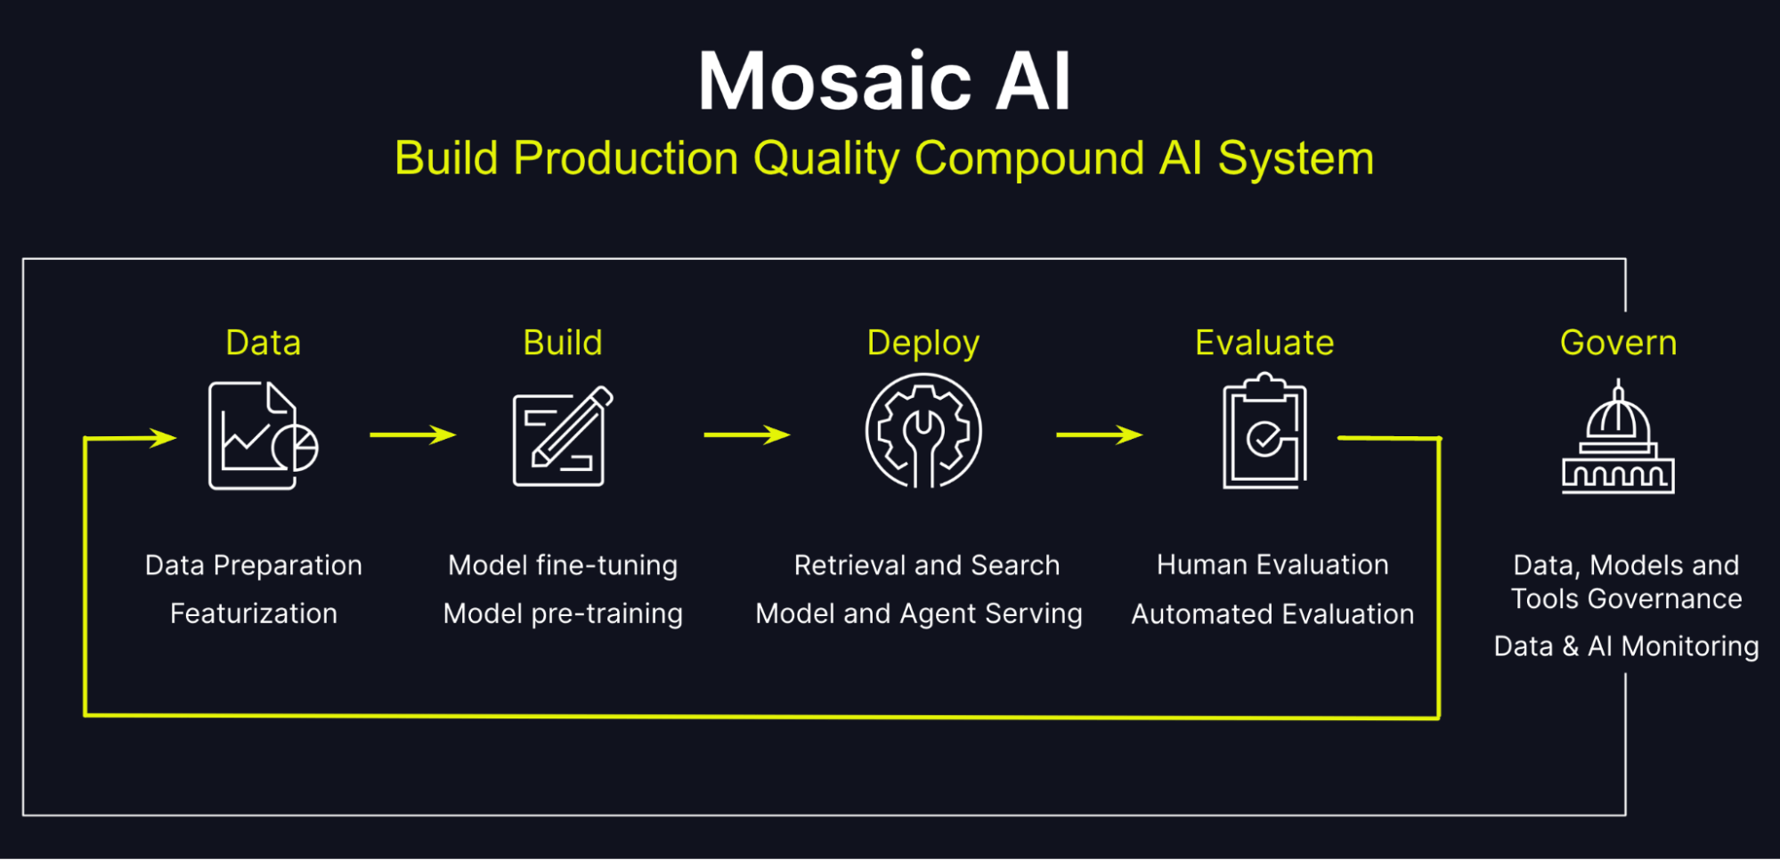
Mosaic AI Agent Framework
The Mosaic AI Agent Framework on Azure Databricks is a feature designed to enhance AI-driven workflows by integrating advanced language models (LLMs) with Databricks' powerful data and analytics platform.
LLM Integration
Seamlessly integrates with popular LLMs, including Azure OpenAI, OpenAI's GPT models, and custom fine-tuned models.
Supports RAG (Retrieval-Augmented Generation) for enhanced information retrieval and accurate responses.
Ease of Use
User-friendly APIs for building, deploying, and monitoring AI agents.
Intuitive dashboards and tools for tracking agent performance.
Data Access
Direct access to Delta Lake and other Azure Databricks data sources for real-time querying and analytics.
Enables LLMs to interact with structured, semi-structured, and unstructured data stored within Databricks.
Unified Ecosystem
Runs on Databricks Runtime, leveraging built-in scalability and optimization for AI and machine learning workloads

Slide 3
Tools for Agents
Unity Catalog functions: Unity Catalog functions are defined and managed within Unity Catalog, offering built-in security and compliance features. Writing your tool as a Unity Catalog function grants easier discoverability, governance, and reuse. Unity Catalog functions work especially well for applying transformations and aggregations on large datasets.
Agent code tools: These tools are defined in the same code that defines the AI agent. This approach is useful when calling REST APIs, using arbitrary code or libraries, or executing low-latency tools. However, this approach lacks the built-in discoverability and governance provided by Unity Catalog functions.

